Slide 1

SSID: zenguest
Password: password
Notes:
Please remove this slide when sharing the document to the public

Slide 2


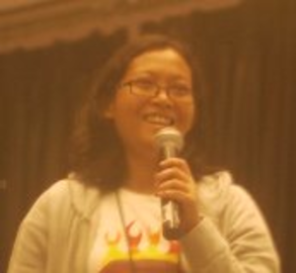




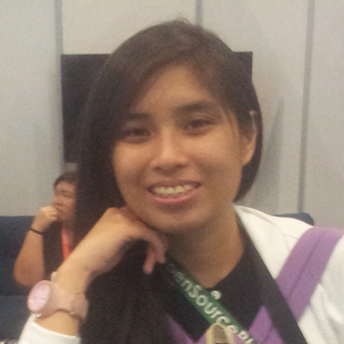
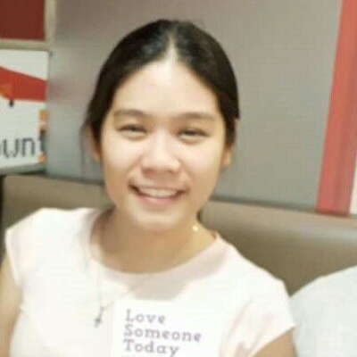


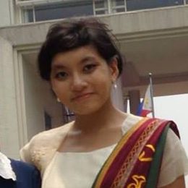

Artificial Intelligence Study Group
Twitter: @wwcodemanila
FB: fb.com/wwcodemanila
#WWCodeManila
#AI
#StudyGroup

Slide 3
Issa Tingzon
Research Fellow
PCARI
Notes:
Please use only the three colors for the content.

Slide 4
New Member’s Introduction

Slide 5

I am <name>
<your current profession>
<why did you join this study group?>
Notes:
Please use only the three colors for the content.

Slide 6
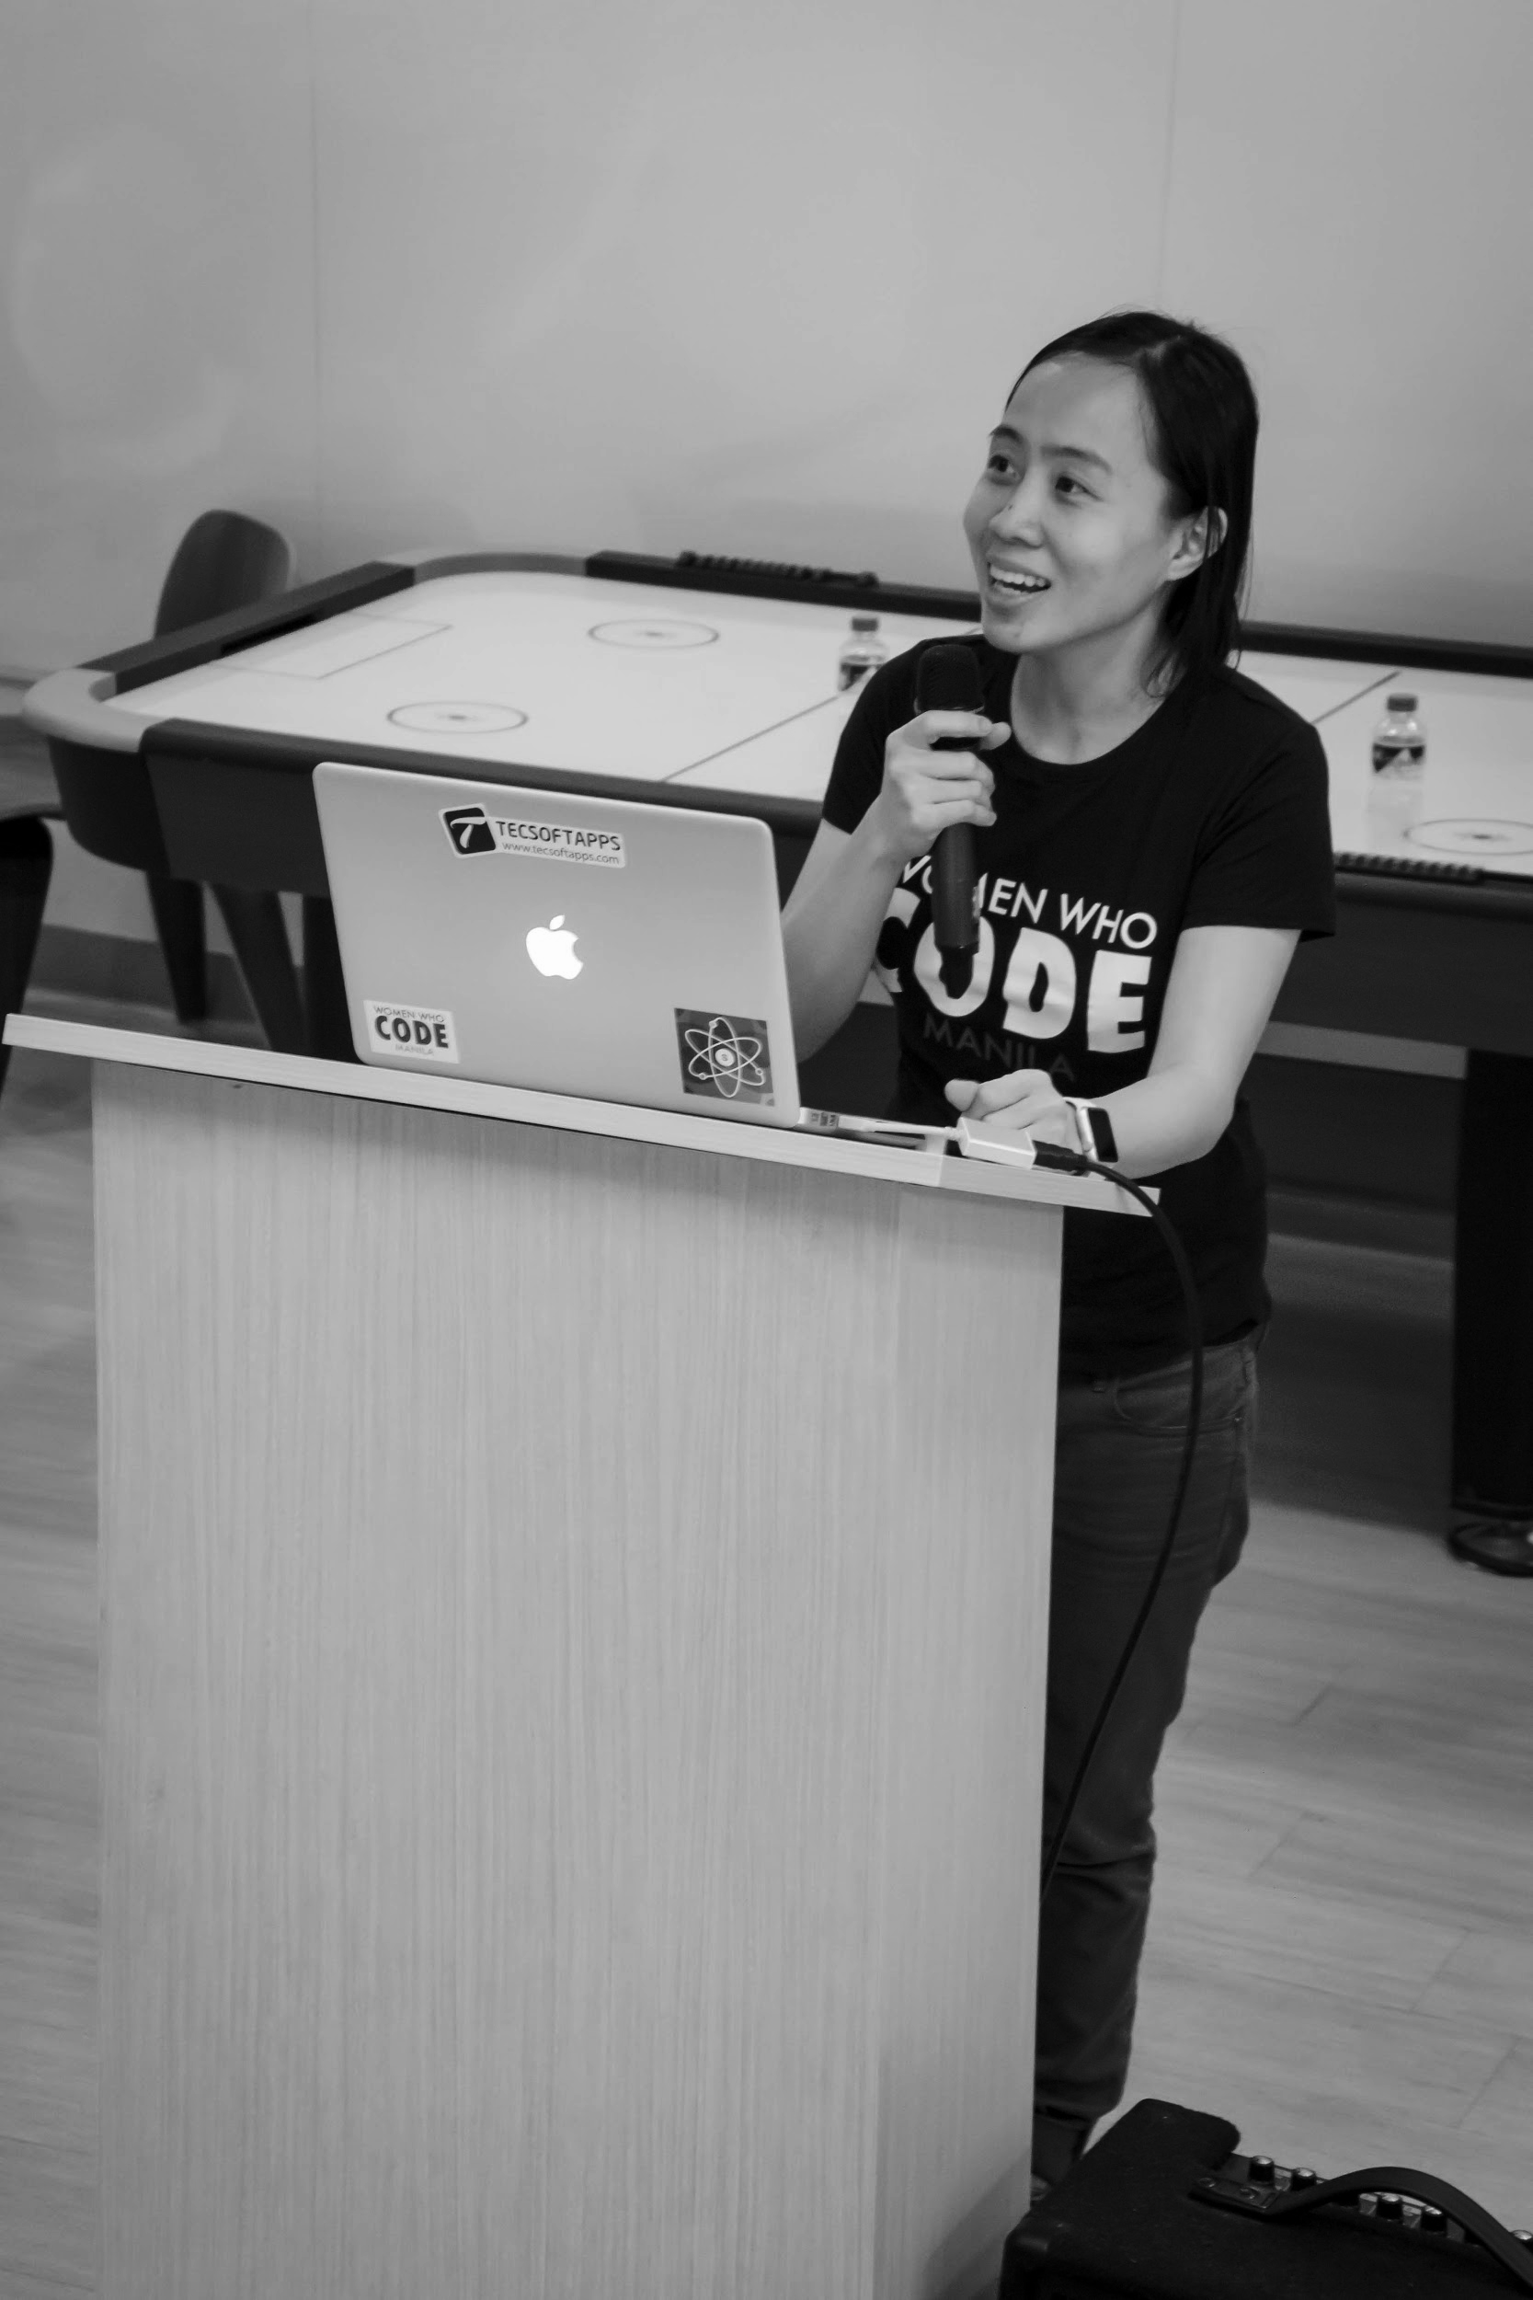

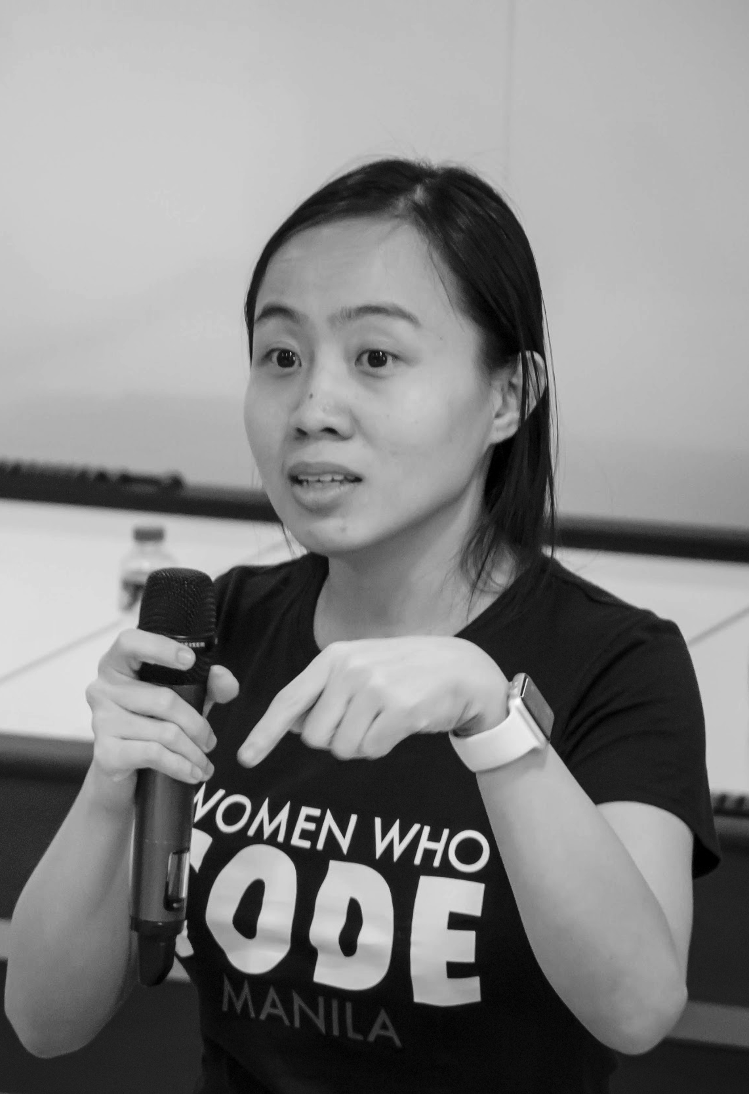
OUR MISSION
Inspiring women to excel in technology careers.

Slide 7
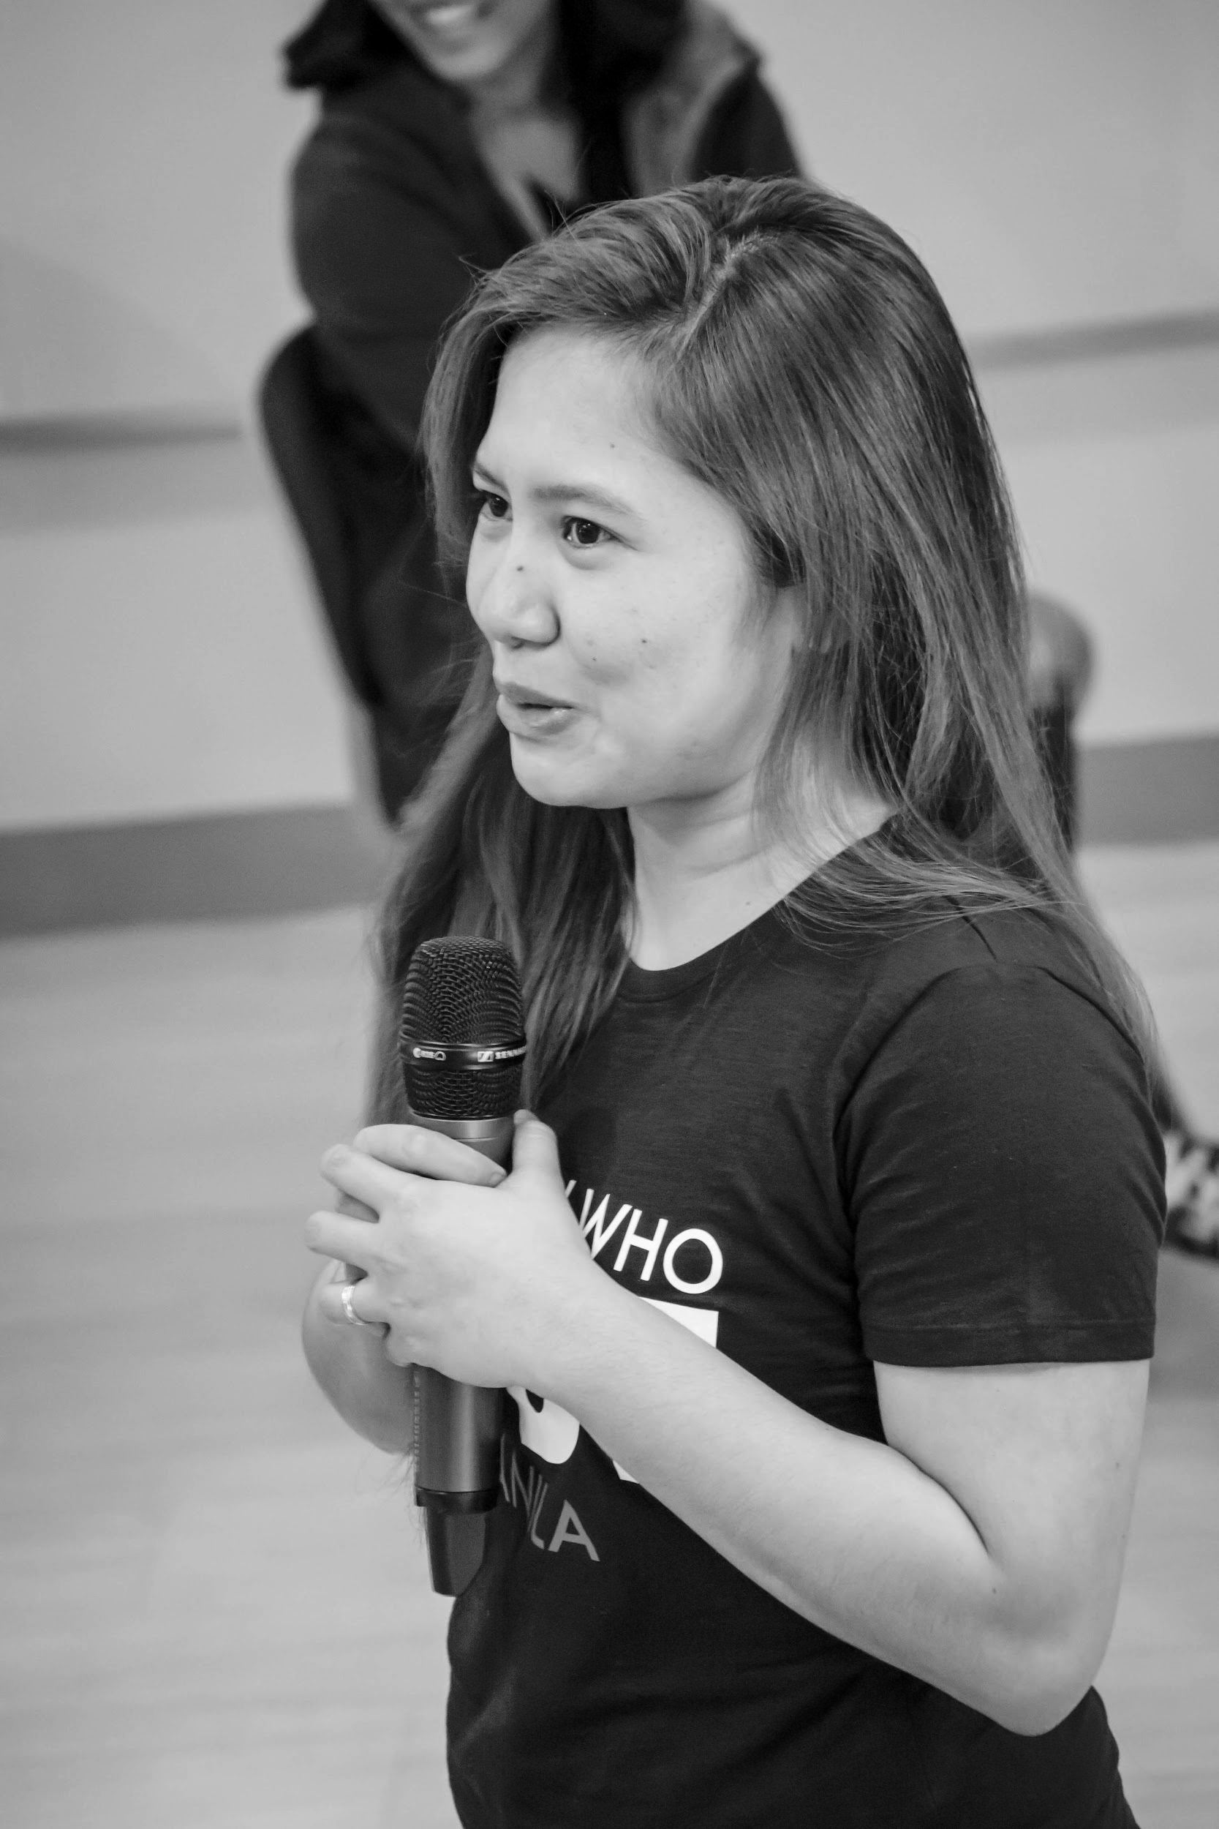
OUR VISION
A world where women are representative as technical executives, founders, VCs, board members and software engineers.

Slide 8
STUDY GROUP
Study groups are events where women can come together and help each other learn and understand a specific programming language, technology, or anything related to coding or engineering.

Slide 9
GUIDELINES
If you have a question, just ask
If you have an idea, share it
Make friends and learn from your study groupmates
Do not recruit or promote your business

Slide 10

REVIEW
Training set, testing set, validation set
Overfitting, underfitting

Slide 11
DECISION TREES
REVIEW

Slide 12
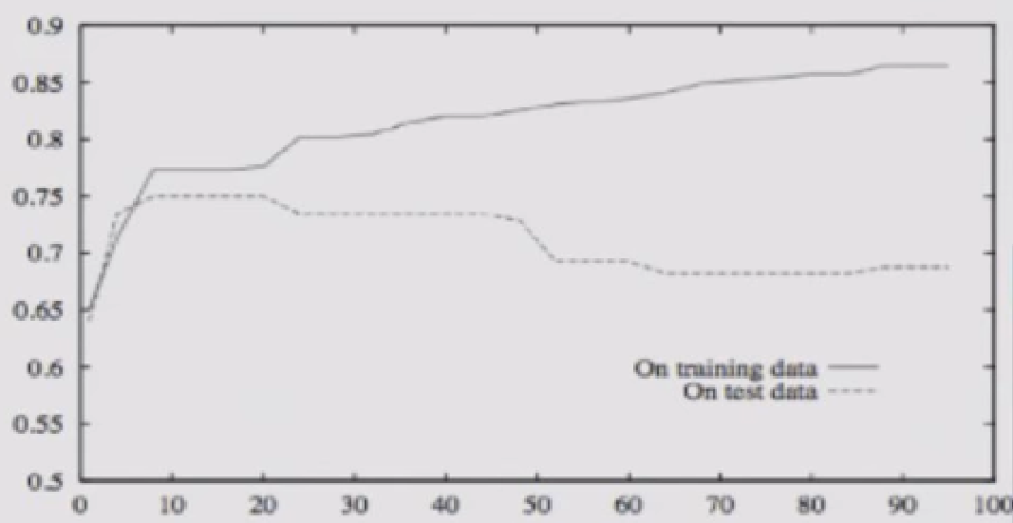
Overfitting in Decision Trees
Recursive algorithm
keeps splitting until all subsets are pure
Can always classify training examples perfectly
Doesn’t work on new data
Accuracy
Size of tree (number of nodes)

Slide 13
Avoid Overfitting
Don’t grow a tree that is too large or has singleton subsets
Set maximum tree depth, max no. of features, etc.

Slide 14
Avoid Overfitting
Don’t grow a tree that is too large or has singleton subsets
Set maximum tree depth, max no. of features, etc.
Remove nodes that are too specific to training data
Grow tree, then prune (based on validation set)
- For each node:
“pretend” remove node + all its children
Measure performance on validation set
Remove nodes that give you the biggest improvement
Repeat until further pruning is harmful

Slide 15
Pros and Cons
Decision Trees

Slide 16
Pros
Interpretable; humans can easily understand
Easily handles irrelevant attributes
Easily handles missing data
Compact after pruning
Very fast at testing time (O(depth))
Can handle categorical and continuous data with ease
C4.5 is an extension of ID3 that handles continuous data and implements pruning

Slide 17
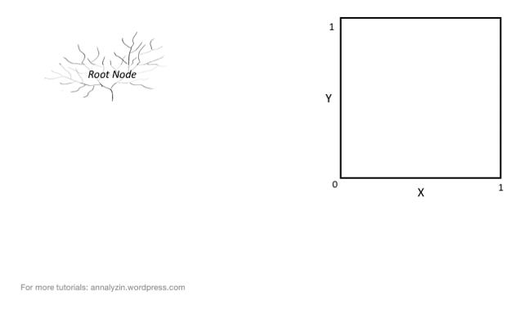
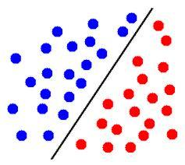
Cons
Only Axis Aligned Splits
Greedy selection of best attribute
Does NOT always result in the optimal tree!
Finding the optimal tree would be too time consuming
exponentially many trees to compare
Prone to Overfitting

Slide 18
RANDOM FORESTS
TOPIC FOR TODAY

Slide 19
Ensemble Methods
Wisdom of the Crowd?
While visiting a livestock fair, Francis Galton (19th century) was intrigued by a simple weight-guessing contest.

Slide 20


Ensemble Methods
Wisdom of the Crowd?
While visiting a livestock fair, Francis Galton (19th century) was intrigued by a simple weight-guessing contest.
The visitors were invited to guess the weight of an ox.

Slide 21
Ensemble Methods
Wisdom of the Crowd?
While visiting a livestock fair, Francis Galton (19th century) was intrigued by a simple weight-guessing contest.
The visitors were invited to guess the weight of an ox.
Hundreds of people participated in this contest but no one individual managed to guess the exact weight: 1,198 lbs.

Slide 22
Ensemble Methods
What surprised Galton was the average of all the guesses came quite close to the exact weight → 1,197 lbs!

Slide 23
Ensemble Methods
What surprised Galton was the average of all the guesses came quite close to the exact weight → 1,197 lbs!
Rationale: Combining different (poor) classifiers can exploit their individual advantages in order to achieve an overall performance that is better than by using each of them separately.

Slide 24
Ensemble Methods
What surprised Galton was the average of all the guesses came quite close to the exact weight → 1,197 lbs!
Rationale: Combining different (poor) classifiers can exploit their individual advantages in order to achieve an overall performance that is better than by using each of them separately.
Poor/Weak Learners – models that are slightly better than random guessing (e.g. decision trees, perceptrons)

Slide 25
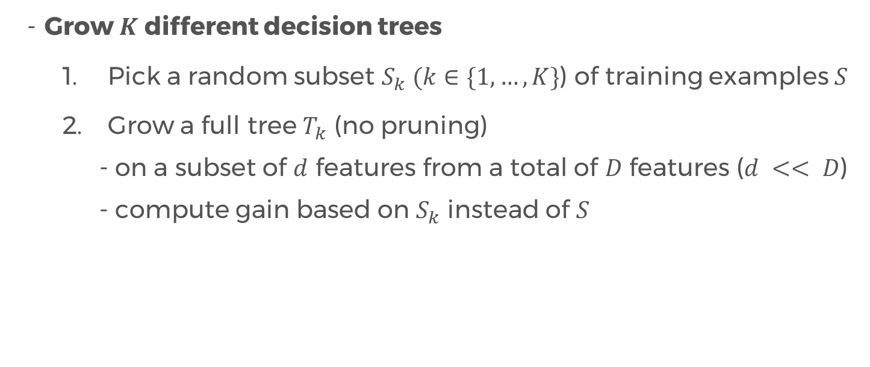
Random Forest
Grow $K$ different decision trees
Pick a random subset $S_{k} (k∈\{1, …, K\}$) of training examples $S$
Grow a full tree $T_{k}$ (no pruning)
- on a subset of $d$ features from a total of $D$ features ($d << D$)
- compute gain based on $S_{k}$ instead of $S$

Slide 26
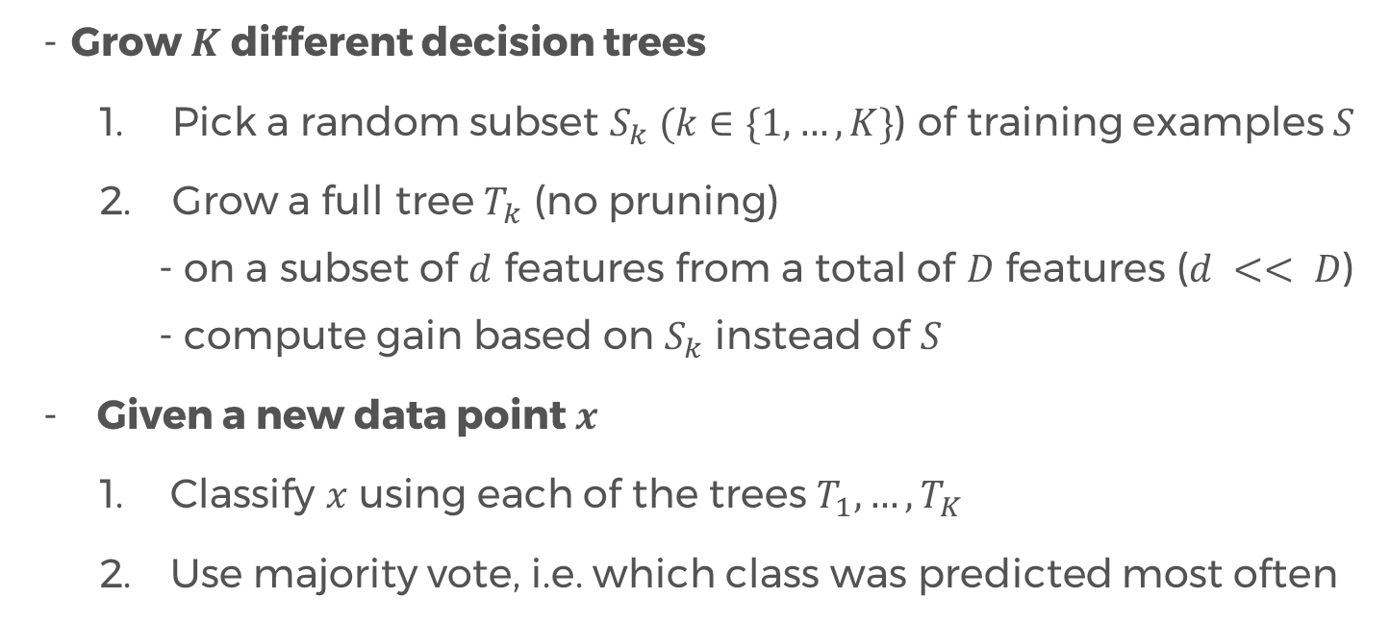
Random Forest
Grow $K$ different decision trees
Pick a random subset $S_{k} (k∈\{1, …, K\}$) of training examples $S$
Grow a full tree $T_{k}$ (no pruning)
- on a subset of $d$ features from a total of $D$ features ($d << D$)
- compute gain based on $S_{k}$ instead of $S$
Given a new data point $x$
Classify $x$ using each of the trees $T_{1}, …, T_{K}$
Use majority vote, i.e. which class was predicted most often

Slide 27
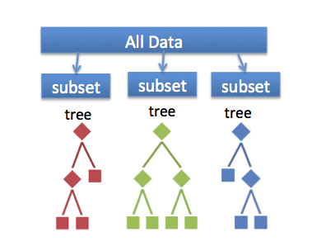
Random Forest

Slide 28
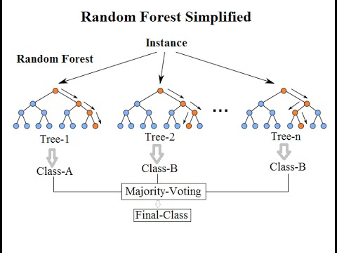
Random Forest

Slide 29
Random Forest
Simple, but state-of-the-art
Image Classification
Object Detection
Object Tracking
Human/ Hand Pose Estimation
- etc.

Slide 30
Why use Random Forest?
RFs require almost no input preparation
RFs can handle binary, categorical, numeric input without need for scaling
RFs perform implicit feature selection
RFs are quick to train
Simplicity
RFs can be grown in parallel
Very little hyperparameters to tune
Can handle multi-class classification seamlessly

Slide 31
Drawbacks of Random Forest
Model size can be huge, and might be slow to evaluate
More trees → better, typically, but slower!
Black box? (Not to us anymore, at least!)

Slide 32
Random Forest for MNIST Dataset
Partner/Group/Individual Presentation

Slide 33
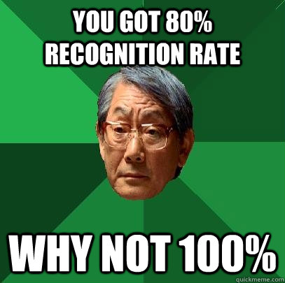
Kaggle Digit Recognizer
https://www.kaggle.com/c/digit-recognizer
Join Kaggle’s digit recognizer competition
Submit your predictions using Random Forest Classifier
Pataasan ng score/rank!

Slide 34
Random Forest in Python
Use scikit-learn’s RandomForestClassifier() method
Focus on optimizing parameters using cross validation
Try different values for parameters n_estimator, criterion, etc.
For cross validation, use cross_val_score and get the mean of the resulting cross validation scores
As you increase the number of trees, evaluation gets slower.
Parallelization might help to speed things up (hint: tweak n_job)
Feature binarization might also help.

Slide 35
References
Decision Tree Lecture by Victor Lavrenko (Youtube)
Random Forests Video by Siraj Raval
Notes:
Please use only the three colors for the content.

Slide 36
T.I.L.
SHARE IT!
In front!
On Twitter: @wwcodemanila
Or FB: fb.com/wwcodemanila
Don’t forget to tag WWCodeManila so we can retweet or share it.
Notes:
Please use only the three colors for the content.

Slide 37
Feedback Form
https://goo.gl/YzSqcS
Please don’t rate the event on meetup.
Not helpful. It is best to just tell your concerns via the feedback form. We are a building a community not a Yelp restaurant.
Notes:
Please use only the three colors for the content.

Slide 38
THANK YOU :)
Notes:
Please use only the three colors for the content.

